Slide 1
The Journey Towards 'Missional'
+Graham Cray
Fresh Expressions
1

Slide 2
Missional?
'Missional is simply an adjective denoting something that is related to or characterised by mission, or has the qualities, attitudes or dynamics of mission.' Christopher Wright 'The Mission of God' 2006
P 24

Slide 3
The journey towards missional
The story does nor develop from direct questions about the church, but about gospel and culture, which leads to questions about the church.
Lesslie Newbigin 'The Other Side of 84' 1983
The Gospel and Culture movement

Slide 4
The journey towards missional
Culture shift and culture gap.
Modernity to Postmodernity,
Christendom to post Christendom.
So new types of church
'Alternative Worship'
'new ways of being church'
'emerging church'
2 different motives

Slide 5
The journey towards missional
But also
'Education for the Church's Ministry'

Slide 6
The journey towards missional
But also
'Education for the Church's Ministry'
The Decade of Evangelism - Alpha

Slide 7
The journey towards missional
But also
'Education for the Church's Ministry'
The decade of Evangelism - Alpha
Growing influence of Evangelicals

Slide 8
The journey towards missional
But also
'Education for the Church's Ministry'
The decade of Evangelism - Alpha
Growing influence of Evangelicals
Springboard

Slide 9
The journey towards missional
But also
'Education for the Church's Ministry'
The decade of Evangelism - Alpha
Growing influence of Evangelicals
Springboard
The Church Planting Movement

Slide 10
The journey towards missional
George Lings: Antecedents to the 'church planting movement'
Ecumenical Movement
(no longer think our way the only way, opens door for greater diversity.)
Small group movement,
(informed partly by base communities and developing into cell church.)
Lay leadership
Charismatic Movement
Liturgical revision
Church growth movement

Slide 11
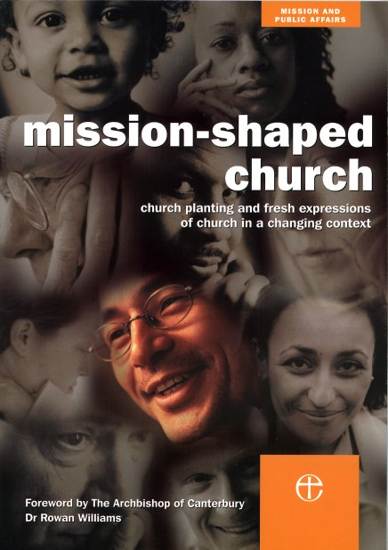
A Tale Of Two Reports

Slide 12
MISSION SHAPED CHURCH
‘church planting and fresh expressions of church in a changing context.’
General Synod
Feb. 2004

Slide 13
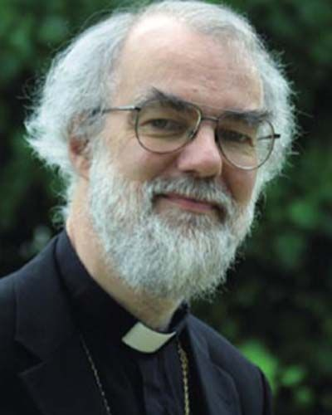
ARCHBISHOP ROWAN
MSC
Mission-Shaped Church
+ ABC
Archbishop of Canterbury
= FEI
Fresh Expressions Initiative

Slide 14
The journey towards missional
A discernible move of the Spirit in our day, drawing on the previous changes, but also drawing the others into this divine mission.' George Lings

Slide 15
The journey towards missional
'The existing parochial system alone is no longer able fully to deliver its underlying mission purpose. We need to recognize that a variety of integrated missionary approaches is required.
A mixed economy of parish churches and network churches will be necessary, in an active partnership across a wider area, perhaps a deanery.
In addition, our diverse consumer culture will never be reached by one standard form of church.

Slide 16
The journey towards missional
One of the central features of this report is the recognition that the changing nature of our missionary context requires a new inculturation of the gospel within our society. The theology and practice of inculturation or contextualization is well established in the world Church, but has received little attention for mission in the West. We have drawn on this tradition as a major resource for the Church of England.'
Inculturation is central to this report because it provides a principled basis for the costly crossing of cultural barriers and the planting of the church into a changed social context. Church has to be planted, not cloned.'
+

Slide 17
The Journey Towards 'Missional'
+Graham Cray
Fresh Expressions
1

