Slide 1
Ministry that informs and transforms the contributions of
Jamie Smith
Frederick Marais
Winterschool
2017

Slide 2

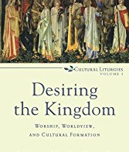
James KA Smith

Slide 3
http://jameskasmith.com/
Jamie Smit on You are what you love

Slide 4
1
0
Statements on missional formation
Notes:
Background of this study:
Five years of experimentation on missional formation.
Strand Street ELC congregation second oldest congregation in SA- 4 year experiment in formation of the leadership
2012-2016 visitation reports of the Cape Synod shows two different pictures
2012- report Seven conflict areas were identified
“the conflicted/poisonous atmosphere in the offices of the congregation. The power struggles between the factions within the church committee have infected the staff and they no longer seem to be working for the better functioning of the congregation”
serious misbehaviour and abusive treatment of others was part of the repertoire of one member of the staff in particular
gossiping, especially if it involves information of a confidential nature
Intervention: conflict resolution was suggested-but I declined the opportunity. I read the report and concluded that we have a congregation with a chronic conflict culture- therefore I suggested an intention formational proses that taught leadership new habits- 3years I have spend time with leadership guiding them into a new lifestyle. I expose them to new habits with the intention to replace the toxic habits.
In the fourth year I did a focusgroup interview with them and spend time to analise it using ALTASTi
Form what analises I have constructed 10 statements on missional formation.
After four years the synod did a visitation again.
2016 report
Focus on mission, member of ICP-networking with other churches in the City Bowl
Children ministry is growing
They celebrate the fact that they are becoming Rainbow-congregation-revering to the cultural mix in membership
Challenges are mentioned but no reverence to conflict

Slide 5
Therefore go and make disciples of all nations, baptizing them in the name of the Father and of the Son and of the Holy Spirit, ²⁰ and teaching them to obey everything I have commanded you. And surely I am with you always, to the very end of the age.” Mat 28:19-20
Notes:
Teach them didasko- to obey my commands
Phil 2;5 be of the same phroneo-attitude; mindset as that of the kenotic Christs
So my question is: how is knowledge transferred into a life of obedience?

Slide 6
1
Habits act as structural gatekeepers of an existing ór emerging self-understanding or culture.
Notes:
Old habit or practices
Gossiping(back stabbing)
Defending my position expecting others to listen to me
loading of information
(preaching and writing letters to congregation)
Long tiring meetings with heated and hostile debates
Council only meet in formal meetings
Prayer as a weapon: praying to slain the enemy

Slide 7
1
toxic habits (gate-keepers) to be
replaced by missional habits
Notes:
New Habit
Affirming the other with a focus on gifts and talents
Listening through echo technique(listening each other into free speach)
Dwelling in the Word- participatory reading of scripture in meetings
Slowing down
Solitude and silence in meetings and retreats
Prayer (meditation and reflection)

Slide 8
2
Formation happens when there is an effective incubator that contains and steers energy towards constructive life-giving processes.
Notes:
Fetus needs a uterus to surwive. Formational incubator-needs a wow to streach youself intenionally; you needs community of supporters; you need a system of accountability within a culture of grace. This is not a new insight. For many centuries we had monastries, and orders that acts as incubators to guide and teahc Dit is ook in die natuur so, ‘n fetus kan net oorleef in ‘n volwasse liggaam indien daar ‘n baarmoeder (uterrus) is wat die brose nuwe lewe beskerm. Gewoontes van die leiers en deelnemers is hierdie “containers” in die verandering van organisasies. (Senge) Hierdie container kan ‘n proses, die effek van ‘n begeleier(mentor), ‘n groep met vaste waardes en ooreenkomste, of natuurlik ‘n liturgie wees, wat die proses van die ontwaking van die nuwe lewe verstaan, beskerm en resekteer. Die klassieke geloofsgewoontes –Ignation disciplines of Lextio divina, Examine prayer, journaling van die kerk is goeie voorbeelde van bogenoemde maar kan ook uitgebrei word met moderne innovasies. In die geval van die gevallestudie is luister(eggo), Wandel in die Woord, Waardering, Gebed van die Hart en Godsvrae gebruik. Die “downloading” of verduideliking van inligting oor die Evangelie, die kerk en die koninkryk is in hierdie geval nie gebruik as strategie (lees skep van ‘n container) nie. oor drie jaar is geen lesing gegee nie, die proses het net bestaan uit die praktiese be-oefening van die gewoontes.

Slide 9
3
New habits
re-focuses the consciousness of a person.
Notes:
In analising the data I discovered that the repetition of these habits over time the consiousness of the leaders were re-focused in a very intersting way, slowly they started to see and hear things that they could not see and hear before- scharmer calls it working through “blind spots”
om sodoende deur hulle blindekolle te kan sien en nuwe velde van waarneming op te merk.(“fields of attention”-Scharmer) Gewoontes is nie in die eerste plek gerig op die bereiking van doelwitte nie, maar die vroming van die bewussyn van die persoon. Die herhaalde ritme ontwikkel nuwe bewussyns kapasiteit (lees nuwe neuron paaie in die brein)

Slide 10

3
I-in-me
I-in-it
I-in-you
I-in-now
Notes:
Scharmer Luister
Field of attention
1.Downloading expecting others to listen to me I-in-me
Then…they became open to new facts-others may have different views, I might not agree but will listen and learn
2.Factual listening I-in-it
Then… people strat to repond in empathy… relations started to heal
3.Empathetic I-in-you
And then they became aware of a voice teaching them about a diffirent future
4. Generative I-in-now
Die patroon van die U-teorie soos hierbo beskrywe is wetmatig, jy kan met ander woorde nie spring van die 1 na 4 nie, maar moet deur intensionale (self)begeleiding deur die proses werk. Die data van my gevallestudie het dit onomwonde bevestig en strook met 100de voorbeelde uit Communitas se begeleiding van prosesse. In die geval van die gevallestudie het leiersgroep vlak 4: Generatiewe luister, na 2 jaar se inoefening van gewoontes, bereik en kon hulle begin om oor hulle identiteit as ‘n geskenk vir die toekoms begin praat. Die implikasie is dat indien daar inligting na mense gekommunikeer word oor bv die toekoms en die koninkryk se ideale van ‘n nuwe mensheid, maar die “gehoor” is primer in die eerste vlak van luister-“ I-in-me”, is hulle vermoë om die boodskap te hoor byna nul, hulle luister maar is eintlik afwesig. Ek dink dit beskryf tot ‘n groot mate wat al vir baie lank in kerke gebeur, ons verduidelik die evangelie en die visie van die Koninkryk maar mense hoor dit nie, dan is ons gewoonte om dit weer te verduidelik wat sonder dat ons dit bedoel mense immuun maak teen die boodskap.

Slide 11
4
Formation is a process of listening and observing-it is an act of slowing down is necessary.
Notes:
It took us 3years of slowing down- 3 retreats and several counsil meetings to learn to slow down in prayer, listening to each other,seemingly doing nothing, doing nothing but in fact much was happening in the unseen consiousness of the leaders.
Verstadiging (slowing down) veroorsaak in moderne mense wat in die kapitalistiese mark-ekonomie moet oorleef (alpha beweging se gerigtheid op produksie en effektiwiteit) soveel angs dat hulle dit normaalweg nie onbegeleid kan doen nie. By die verhoging van angs neem die reptiee-brein oor en kaap die proses. Dit is fisiologies vir die reptile-brein onmoontlik om te luister. Let vir ‘n oomblik op hoe verslaaf ons media byvoorbeeld is aan die deurgee van inliging wat angs opjaag- lees net die opskrifte koerante.

Slide 12
5
The (trans)formation
of the consciousness follows a specific pattern.
Notes:
I was surpiced to discover that the formation follows a specific pattern
Scharmer Luister
Field of attention
1.Downloading I-in-me
2.Factual listening I-in-it
3.Empathetic I-in-you
4. Generative I-in-now
Die patroon van die U-teorie soos hierbo beskrywe is wetmatig, jy kan met ander woorde nie spring van die 1 na 4 nie, maar moet deur intensionale (self)begeleiding deur die proses werk. Die data van my gevallestudie het dit onomwonde bevestig en strook met 100de voorbeelde uit Communitas se begeleiding van prosesse. In die geval van die gevallestudie het leiersgroep vlak 4: Generatiewe luister, na 2 jaar se inoefening van gewoontes, bereik en kon hulle begin om oor hulle identiteit as ‘n geskenk vir die toekoms begin praat. Die implikasie is dat indien daar inligting na mense gekommunikeer word oor bv die toekoms en die koninkryk se ideale van ‘n nuwe mensheid, maar die “gehoor” is primer in die eerste vlak van luister-“ I-in-me”, is hulle vermoë om die boodskap te hoor byna nul, hulle luister maar is eintlik afwesig. Ek dink dit beskryf tot ‘n groot mate wat al vir baie lank in kerke gebeur, ons verduidelik die evangelie en die visie van die Koninkryk maar mense hoor dit nie, dan is ons gewoonte om dit weer te verduidelik wat sonder dat ons dit bedoel mense immuun maak teen die boodskap.

Slide 13
5
I-in-me
I-in-it
I-in-you
I-in-now
Notes:
Scharmer Luister
Field of attention
1.Downloading expecting others to listen to me I-in-me
Then…they became open to new facts-others may have different views, I might not agree but will listen and learn
2.Factual listening I-in-it
Then… people strat to repond in empathy… relations started to heal
3.Empathetic I-in-you
And then they became aware of a voice teaching them about a diffirent future
4. Generative I-in-now
Die patroon van die U-teorie soos hierbo beskrywe is wetmatig, jy kan met ander woorde nie spring van die 1 na 4 nie, maar moet deur intensionale (self)begeleiding deur die proses werk. Die data van my gevallestudie het dit onomwonde bevestig en strook met 100de voorbeelde uit Communitas se begeleiding van prosesse. In die geval van die gevallestudie het leiersgroep vlak 4: Generatiewe luister, na 2 jaar se inoefening van gewoontes, bereik en kon hulle begin om oor hulle identiteit as ‘n geskenk vir die toekoms begin praat. Die implikasie is dat indien daar inligting na mense gekommunikeer word oor bv die toekoms en die koninkryk se ideale van ‘n nuwe mensheid, maar die “gehoor” is primer in die eerste vlak van luister-“ I-in-me”, is hulle vermoë om die boodskap te hoor byna nul, hulle luister maar is eintlik afwesig. Ek dink dit beskryf tot ‘n groot mate wat al vir baie lank in kerke gebeur, ons verduidelik die evangelie en die visie van die Koninkryk maar mense hoor dit nie, dan is ons gewoonte om dit weer te verduidelik wat sonder dat ons dit bedoel mense immuun maak teen die boodskap.

Slide 14
6
The pattern of (trans)formation of consciousness involves the reptile-, mammal- and human-brain .
Notes:
• Brein stam of Reptiel brein: Emosie en aksie
• Limbiese brein of “Mammal”: sekuriteit en relasies
• Neocortex: Vertroue en vermoë om groter prentjie te sien
Die ooreenstemming met Scharmer sou soos volg gemaak kon word:
Scharmer Luister Field of attention Brein
1.Downloading I-in-me Reptiel
2.Factual listening I-in-it Limbies
3.Empathetic I-in-you Limbies
4. Generative I-in-now Neocortex

Slide 15
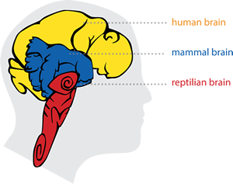
6

Slide 16
7
Refocusing consciousness is a counter intuitive kenotic movement of relinquishing (power) positions.
Notes:
Hierdie is aflegging, maar ter selfdertyd die opneem ‘n nuwe posisie van waarneming. Uit die vorige is dit duidelik hoe belangrik ‘n “container” is om bg risiko’s van “magsverlies” te loop. In die proses ontvang die persoon egter nuwe insigte en word daarmee ‘n nuwe “toekoms” aangebied. Wat dus vir die moderne mens voel soos ‘n proses van vernietiging is uiteindelik ‘n proses van die ontvangs van ‘n nuwe toekoms.(sien die verhoging van Christus) Sentraal hierin is die vermoë om ons veronderstellings te kan bevraagteken en erkenning te gee wanneer ons verkeerd is- ons noem dit skuldbelydenis in die kerk.

Slide 17
8
Formation creates mobility & adaptable in relationships.
Notes:
Exesising the habits over time developes mobility and adaptability in relationships- this is very important for our missional task when crossing boundaries.
Die in-oefening van die vermoe tot introskepsie en die gepaardgaande aflegging van vaste posisies wat verdedig moet word, skep die vermoë om verhoudings te kan bou met mense van wie ek voorheen sou verskil en natuurlik daarmee die vermoë om invloed op hulle uit te oefen. Die gewoontes, of container wat hier wesenlik is, is ‘n waarderende posisie teenoor ander. Waardering veroorsaak in my ‘n nuwe posisie teenoor die ander en ook ‘n onafwendbare nuwe posisionering van die ander teenoor my. Bevestiging is in terme van volwasse leer een van die mees effektiewe maniere tot leer en verandering. Met herhaalde waardering word die potensiaal geopen om ‘n
Alpha-rithym or movement reacts on external pressure and result in alienation of the self.
Die Betha beweging is ‘a rithym or moverment towards the internal longing of self-dicovery or healing movement of the Holy Spirit.

Slide 18
9
Formation develops the ability to see the future and to receive the guidance of the HS
Notes:
The surprice of this study was when I realised that formation proseeds or liberate a new imagination. In this case study the ability to see-or acknoledge the unexpected future of the Reign of Christ only apears after two years. The language of the Gosple seems only to start to make sence after the periode of intensional formation. We preach and teach to people how do not have the epistomolgy to absorb the langues of the Gosples.
Een van die grootste verassing vir my was hierdie ontdekking in die studie. Protestante verstaan die proses verkeerd, ons gee eers inligting wat ons wil hê mense moet verstaan en dan hoop ons hulle sal dit dan gaan leef. Ons moet dit anders om benader. Ons moet die vermoë van mense om oop te wees vir ‘n nuwe toekoms, ontwikkel deur vorming, en dit sal hulle soos sponse maak wat oop en gereed is vir nuwe kennis. In die gevallestudie verduidelik die predikant hoe hy in die konflik gepraat, gepreek en geskryf het met geen effek nie. Na drie jaar van vorming is dieselfde leiers gretig om nuwe “inligitng” te ontvang en het sy lering baie meer effek.

Slide 19
1
0
Formation requires a public vow and koinonia of accountability that spans a life-time.

Slide 20
Therefore go and make disciples of all nations, baptizing them in the name of the Father and of the Son and of the Holy Spirit, ²⁰ and teaching them to obey everything I have commanded you. And surely I am with you always, to the very end of the age.” Mat 28:19-20
Notes:
Teach them didasko- to obey my commands
Phil 2;5 be of the same phroneo-attitude; mindset as that of the kenotic Christs
So my question is: how is knowledge transferred into a life of obedience?

Slide 21
Ministerial formational strategy

Slide 22

Practices

Slide 23
Practices
Missional
formation(Operating system)
How?
Identity (missional community)
Who?
Theology (missio Dei)
Why?

Slide 24
Review and recall our opening “Martian anthropology” of the mall,[ 6] which took this familiar phenomenon that we find in every city, which we might visit every week, and suggested that it is actually a religious space because it is suffused with practices that constitute a kind of worship.
Smith, James K. A.. Desiring the Kingdom (Cultural Liturgies): Worship, Worldview, and Cultural Formation (p. 93). Baker Publishing Group. Kindle Edition.

Slide 25
By the same token, Christian worship needs to be intentionally liturgical, formative, and pedagogical in order to counter such mis-formations and misdirections.
Smith, James K. A.. Desiring the Kingdom (Cultural Liturgies): Worship, Worldview, and Cultural Formation (p. 88). Baker Publishing Group. Kindle Edition.

Slide 26
Why missional formation is complex?
It is contra the dominant culture
It is contra the Christendom ecclesiology
It requires a broader anthropology-understanding that humans agents of and for love.

Slide 27
Containers for formation
Identify toxic habits-prevent the vision to succeed
Construct counter life-giving habits and containers that protect the new life from internal and external toxic forces

Slide 28
Habits
Concrete intentional action(s)-practice
Perform in a specific rhythm (every…)-”public commitment”
Practice becomes a habit over time
Until it becomes new habitus

Slide 29
a Container
The dialogue is a “container…. (T)hat can hold human energy, so that it can be transformative rather than destructive (Peter Senge)
For the alchemist transformation was a process involving the interaction of elements within a closed, transparent container in relation to a carefully tended fire
The normal chemistry of an adult human body would be toxic to an embryo

Slide 30
Formational containers are
An commitment to practice a specific concrete action(s)
Safe spaces that protect from the internal and external toxic forces in failure-allows time for practise up to the point of self-mastering
Understands that growth needs time
Requires gracious systems of accountability
Protects from to much ambition-Understands “less is more”

Slide 31
Missioanle Toepassings/apps
How?
Operting system
IOS/Anroid
Who?
Apple / nokia / samsung
What?
smartphone

Slide 32
Formational apps in ministry
Listening as pastoral discipline
Discerning meetings
100days of transformation
Mentorship

Slide 33
Build a formational Container for formation
Less is more
Public commitement (coach or group)
Concrete and specific
Keep on to the point of self mastering
Soft on person strict on process

Slide 34
Formational leadership

Slide 35
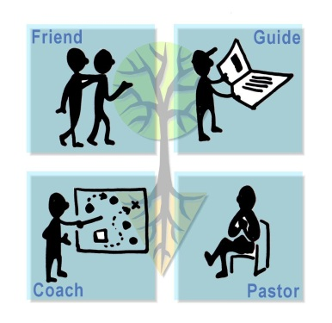
Leadership roles in formation

Slide 36
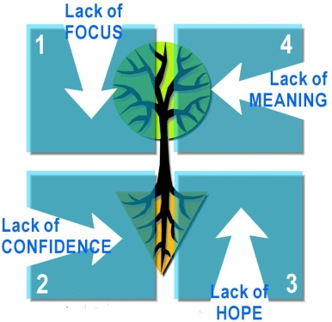
Formational challenges

Slide 37
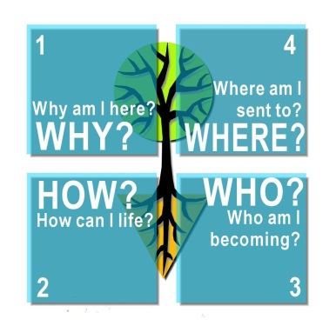
Core questions in formation

Slide 38
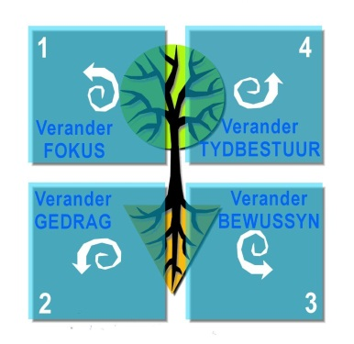
Formational transformation(s)

