Slide 2
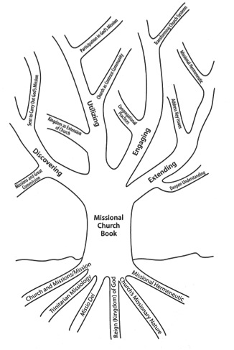
Book Overview
Part I: History and development of missional conversation
Concepts influencing missional conversation
Revisiting seminal work Missional Church
Mapping missional conversation
Part II: Perspectives that extend the missional conversation
Expanding and enriching theological frameworks
Missional engagement with culture in a globalized world
Missional practices of church life and leadership

Slide 3
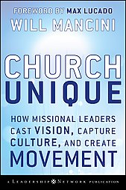
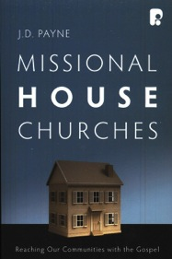
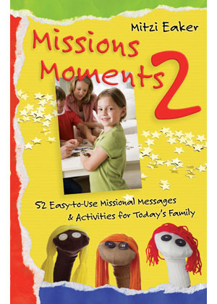
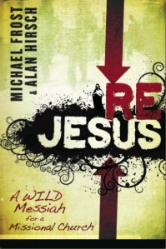
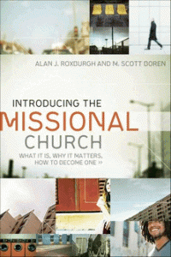
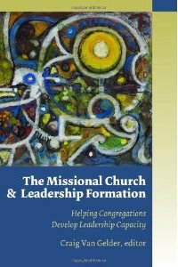
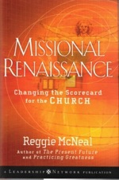
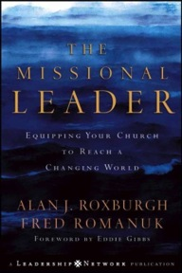
“Missional”?!?
“The word ‘missional’ seems to have traveled the remarkable path of going from obscurity to banality in only one decade.”
—Alan Roxburgh

Slide 4
Four Common Themes in the Literature
God is a missionary God who sends the church into the world
God’s mission in the world is related to the reign (kingdom) of God
The missional church is an incarnational (vs. attractional) ministry
The internal life of the missional church focuses on every believer living as a disciple engaging in mission

Slide 5
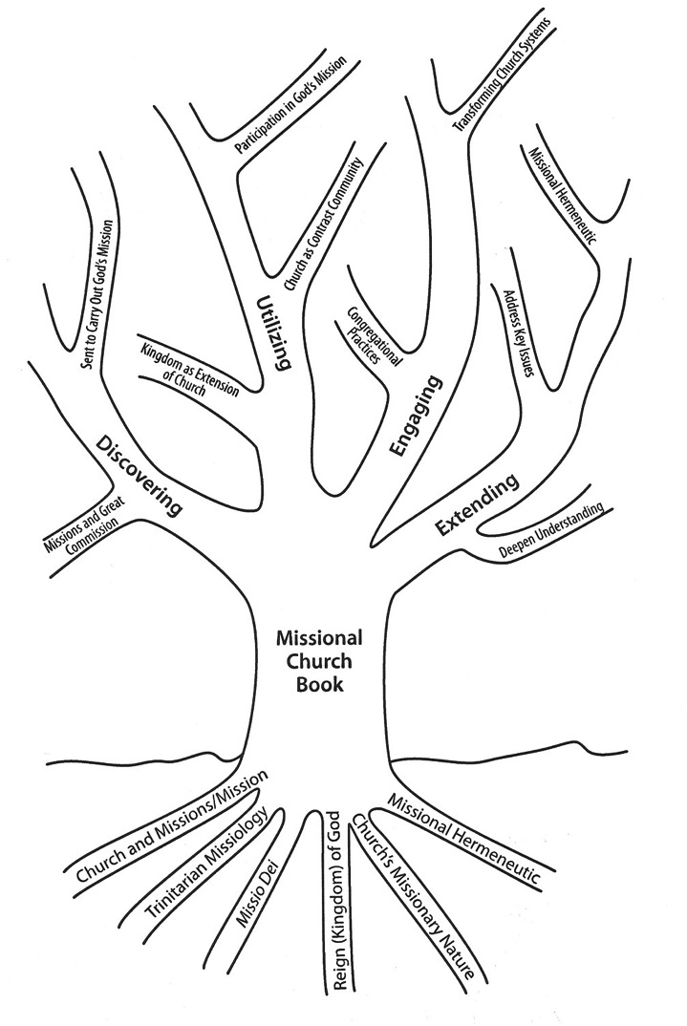
Mapping the Conversation

Slide 6
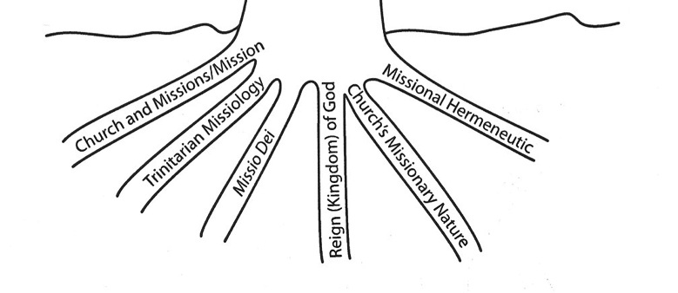
Concepts Influencing the Conversation
Church and missions/mission
Trinitarian missiology—God is a sending God
Reign (Kingdom) of God
Missio Dei (Mission of God)
Church’s missionary nature
Missional hermeneutic

Slide 7
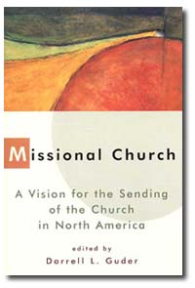
Revisiting Missional Church
Underdeveloped concepts, unresolved theological issues
Trinitarian missiology
Relationship of missio Dei and Reign of God
Church and culture/world
Anabaptist and Reformed strains
Worship, sacraments, ordination
Historical ecclesiologies

Slide 8
Missio Dei and Reign of God
Specialized views
Church embodies reign of God
Church witnesses to reign of God
Generalized secular views
God’s mission unfolds through secular history
God’s mission unfolds in the midst of secular history
Integrated view
Church participates in God’s continuing creation and redemptive mission

Slide 9
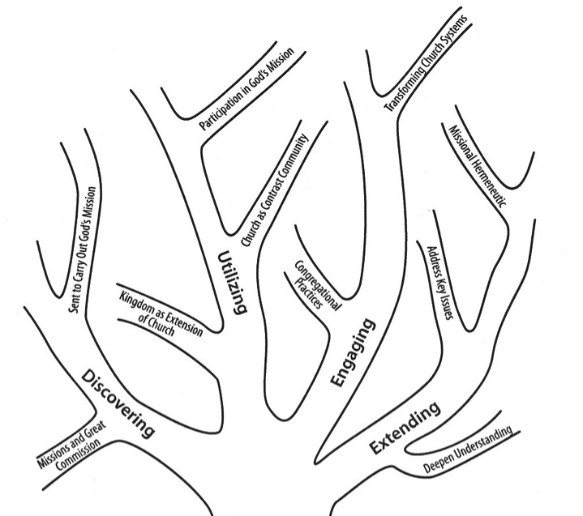
Mapping the Literature
Discovering
Missions/Great Commission
Utilizing
Kingdom as extension of church; participating in God’s mission; church as contrast community
Engaging
Congregational practices; transforming systems
Extending
Addressing key issues; missional hermeneutic; deepen understanding

Slide 10
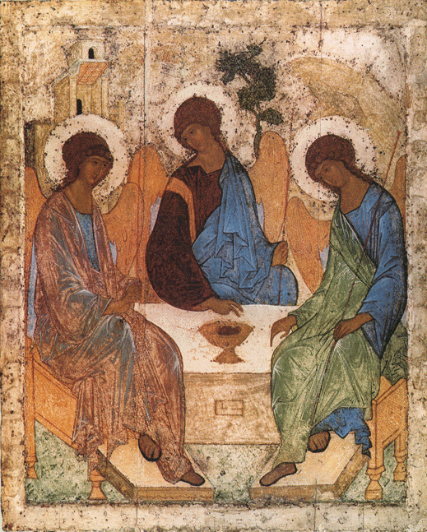
Expanding and Enriching Theological Frameworks
Social and sending Trinity
Mission in image of Trinity as participation in God’s communal, creative, reconciling movement in world
Reciprocity, mutuality

Slide 11
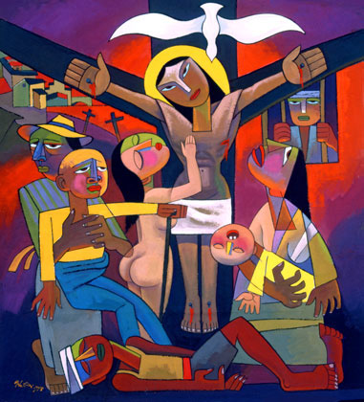
Expanding and Enriching Theological Frameworks, cont.
From imitation to participation
Creation, incarnation, passion (cruciform mission)
Spirit
Relational anthropology

Slide 12
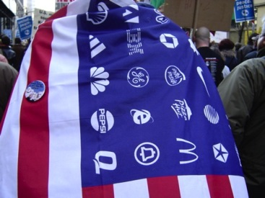
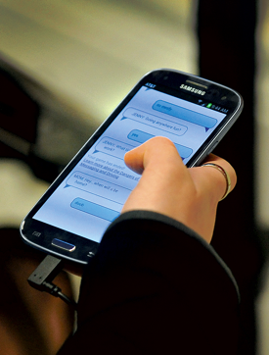
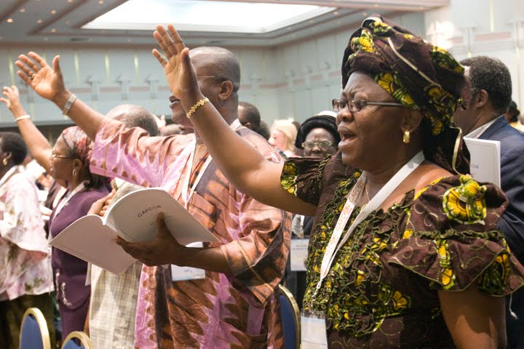
Missional Engagement with Culture in Globalized World
21st century cultural complexity
Hybridity
Globalization
‘Neighborhoods’ in a networked world
Reversals of global mission
Creation and culture
Hospitality of world
Missional church in public

Slide 13
Missional Practices of Church Life and Leadership
Missional imagination
Missional discipleship practices
Participatory missional leadership
Rethinking church organization
Missional church planting

Slide 14
Discussion

