Slide 1
Tommy O’Kennedy
1. Stories
Bob Buford
SA stories

Slide 2
2. My Mission Statement
Inspire and equip
Leaders
To live a life of significance

Slide 3
3. Problem
Most people are over prepared for the first half of life and underprepared for the second half.
And there’s no university for the second half of life.
Peter Drucker

Slide 4
EPHESIANS 2:10
For we are God’s workmanship,
created in Christ Jesus
to do good works,
which God prepared in advance for us
to do
What did God prepared us to do ???

Slide 5
4. Success to Significance Sigmoid Curve
SUCCESS
Notes:
[Vir aanbieder: Meer inligting oor “Sigmoid Curve” verwys na hoofstuk 13 (ongeveer bl 170) van HalfTime boek.]
HalfTime is ‘n reis (journey) – nie ‘n gebeurtenis of ‘n besluit nie.
Die Sigmoid Kurwe kan gebruik word om ons te help om ons lewensreis te verstaan:
Eerste kurwe
Baie van ons verlaat skool/college/universiteit en begin werk.
Dit neem ‘n rukkie om ons voete te vind.
Dan vind ons ons ritme en begin bemeester hierdie lewensreis.
Maar indien ons hierdie sukses van die eerste deel van ons lewe vir te lank najaag, begin dit ons inhaal.
Dit mag gebeur omdat:
Die volgende transaksie sy glans verloor
Ons gesondheid ly onder die druk
Verhoudinge begin verbrokkel (bv huwelik, kinders)
Een of ander krisis gebeur (bv dood van geliefde, werk verloor, leë nes, ens.)

Slide 6
Sigmoid Curve
SIGNIFICANCE
A
B
SUCCESS
Notes:
Hierdie nuwe kurwe verteenwoordig ‘n nuwe fokus op jou lewe.
My fokus verskuif nou van myself af na God en my medemens – hoe kan ek die eerste seisoen van my lewe as platform gebruik om God en ander te dien?
Die nuwe kurwe verteenwoordig ‘n hartsverandering en nie noodwendig ‘n verandering van beroep nie.

Slide 7
Bob Buford
SUCCESS means using your knowledge and experience (time, talent, treasure) to satisfy yourself
SIGNIFICANCE means using your knowledge and experience (time, talent, treasure) to change the lives of others

Slide 8
Dallas Willard
SUCCESS
Has more to do with outcomes I am in charge of.
SIGNIFICANCE
Has more to do with outcomes I am not in charge of.
We resign the outcomes to God. We let a power beyond ourselves take care of them.

Slide 9
SUCCESS
Focuses on my action, my control and my outcomes.
SIGNIFICANCE
It is found in a much larger context.
I am not running that context.
The step of surrender is crucial because surrender allows me to release the outcome.

Slide 10
FROM SUCCESS TO SIGNIFICANCE
Three Levels of Performance
Significance 
Success 
Survival
Surrender
Notes:
Hierdie reis is dus eintlik ‘n reis waarin ek myself moet oorgee (surrender) aan God en Sy plan vir my lewe.

Slide 11
I Am The Beloved
Serve God
Serve people
SIGNIFICANCE
A
HALFTIME
B
I am what ...
I have
I do
others say of me
SUCCESS
Notes:
Vanuit Henri Nouwen se perspektief sal die eerste seisoen beskryf kan word as ‘n lewe wat draai rondom:
“I am what I have, I do & others say/think of me”.
[I did it MY way.]
As gevolg van ‘n nuwe verstaan van my identiteit, nl. “I am the beloved” verander my fokus na ‘n lewe van diens aan God en ander.

Slide 12
5. The Journey
Coaching (1:1)
Forums (Group Coaching: 6 – 8 in a group)
One year commitment (4 hours once a month)
Connecting
Mentoring
Life long Journey (Enduring impact)

Slide 13
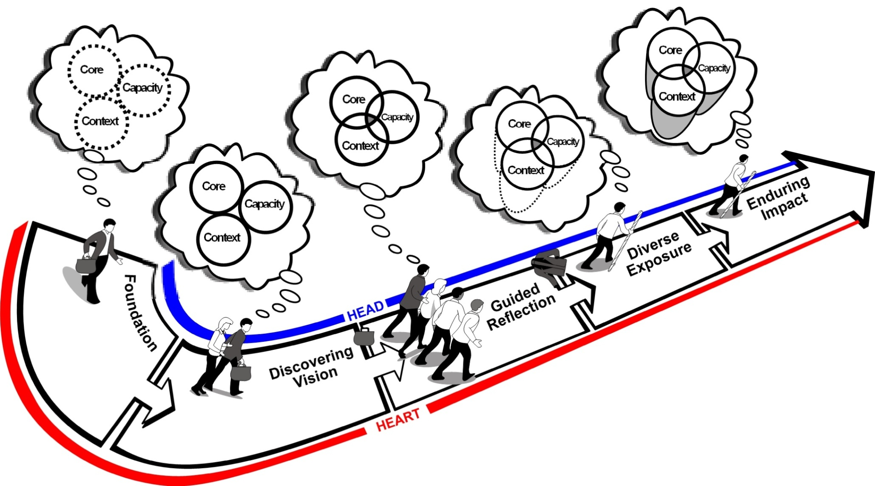
THE HALFTIME JOURNEY Foundation
Enduring
Impact
Diverse
Exposure
Guided
Reflection
Discovering Vision
Foundation
Notes:
Kom ons begin die reis met jou fondasie.

Slide 14
Core
Assessments
Analysis
Strategy
Low Cost Probes
Action
Context
Capacity
Prayer
Circumstances
Scripture
Godly Friends

